Slide 1


TALENT CORNER HR SERVICES MARKETING STRATEGY

Slide 2
TALENT CORNER HR SERVICES strategy and analysis

Slide 3
priorities
Hiring Activity should be increased in the Northern Region
Focus on Healthcare and Life sciences and Real Estate
Company Size greater than 250 should be prioritized
Employee experience greater than 16 Years should be targeted
Prime cities in order Ahmedabad, Delhi NCR, Jaipur, Kolkata, Vadodara, and Baroda
Employee Referral and LinkedIn Hiring to be encouraged
Emerging Roles such as AI and Machine learning, Analytical Thinking, and related roles should be given priority.
Total social media makeover

Slide 4
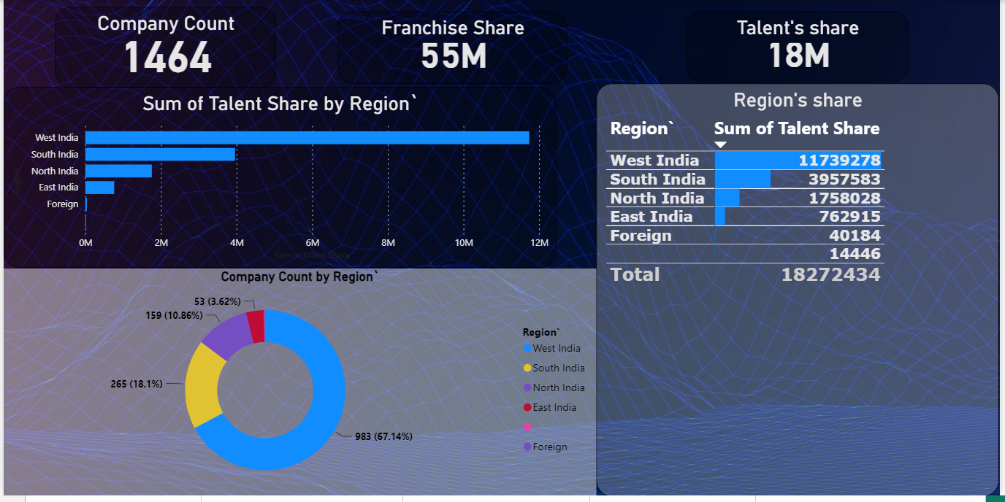
2023-24 Talent’s Regional share

Slide 5
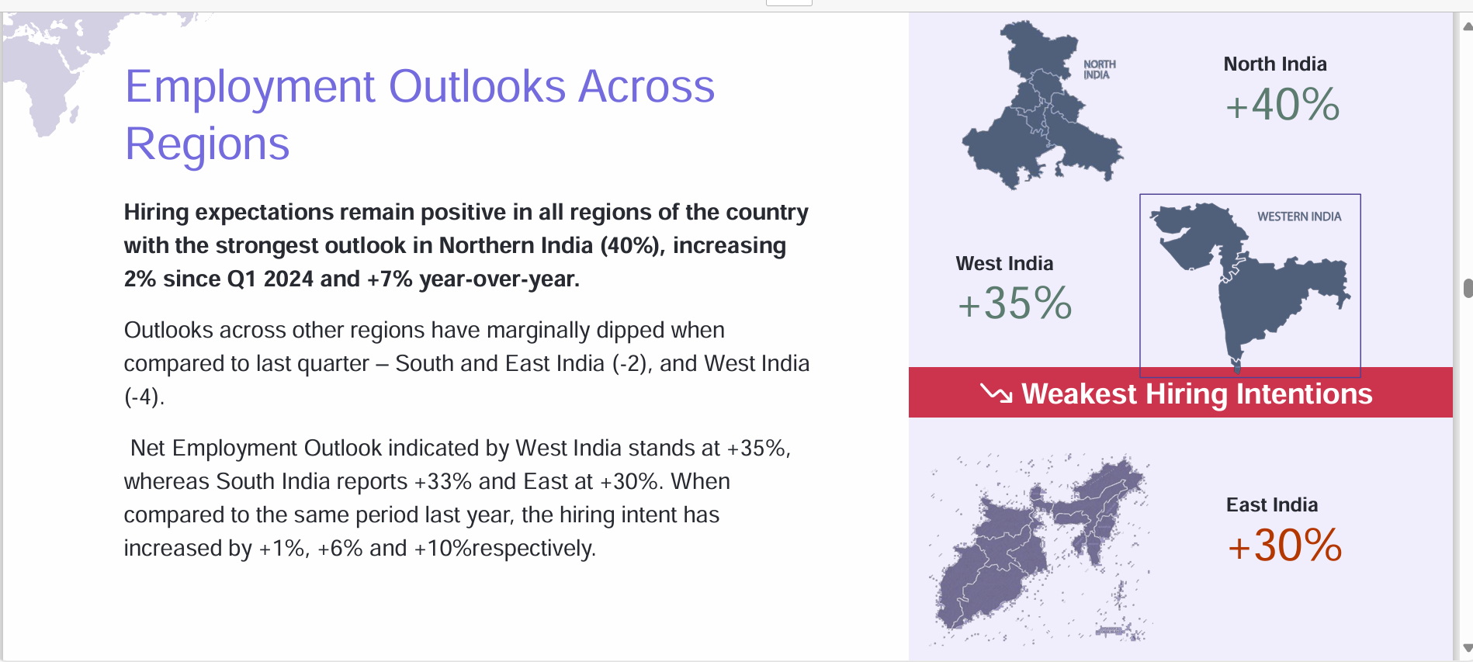
According to 2023-24 data, the majority of our profit share came from Western India, approximately 68% of our clients, while 18% and 11% came from South India and North India, respectively.
Based on the report by Manpower Group Employment Outlook Survey 2024, the strongest outlook for hiring in India in quarter two is in North India.

Slide 6
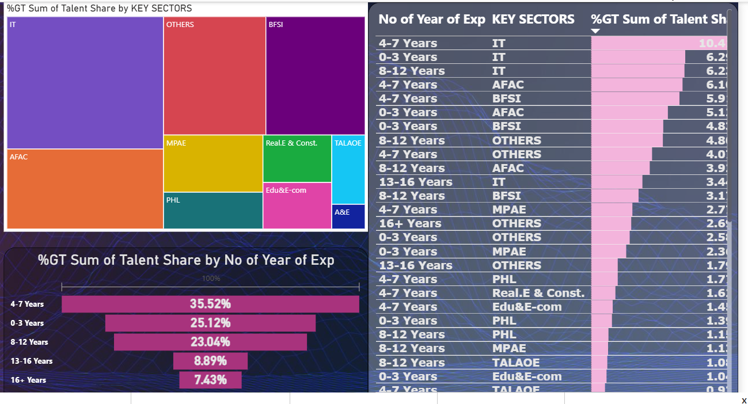
2023-2024 Key sectors

Slide 7
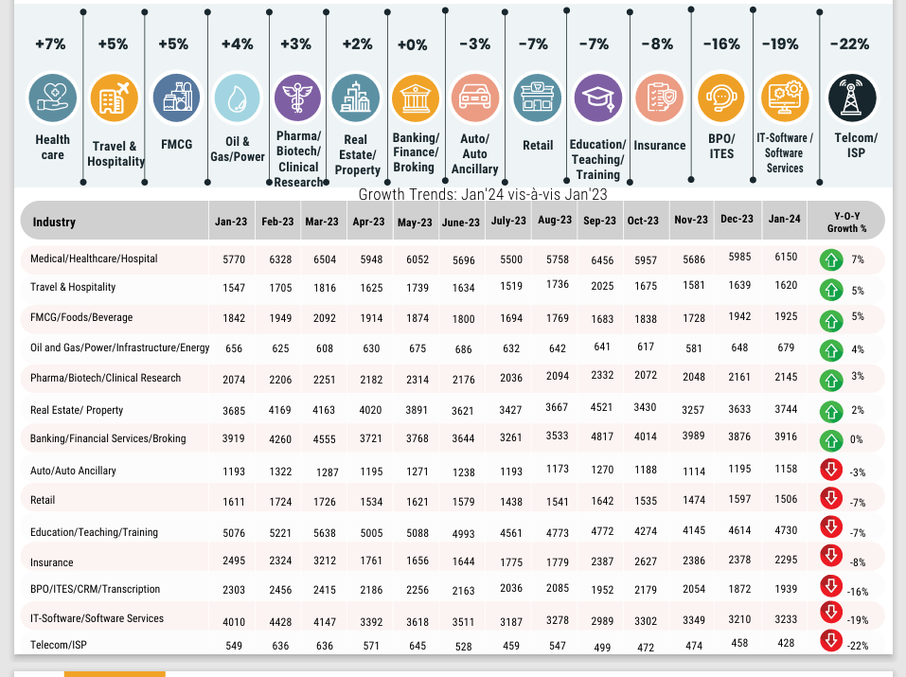
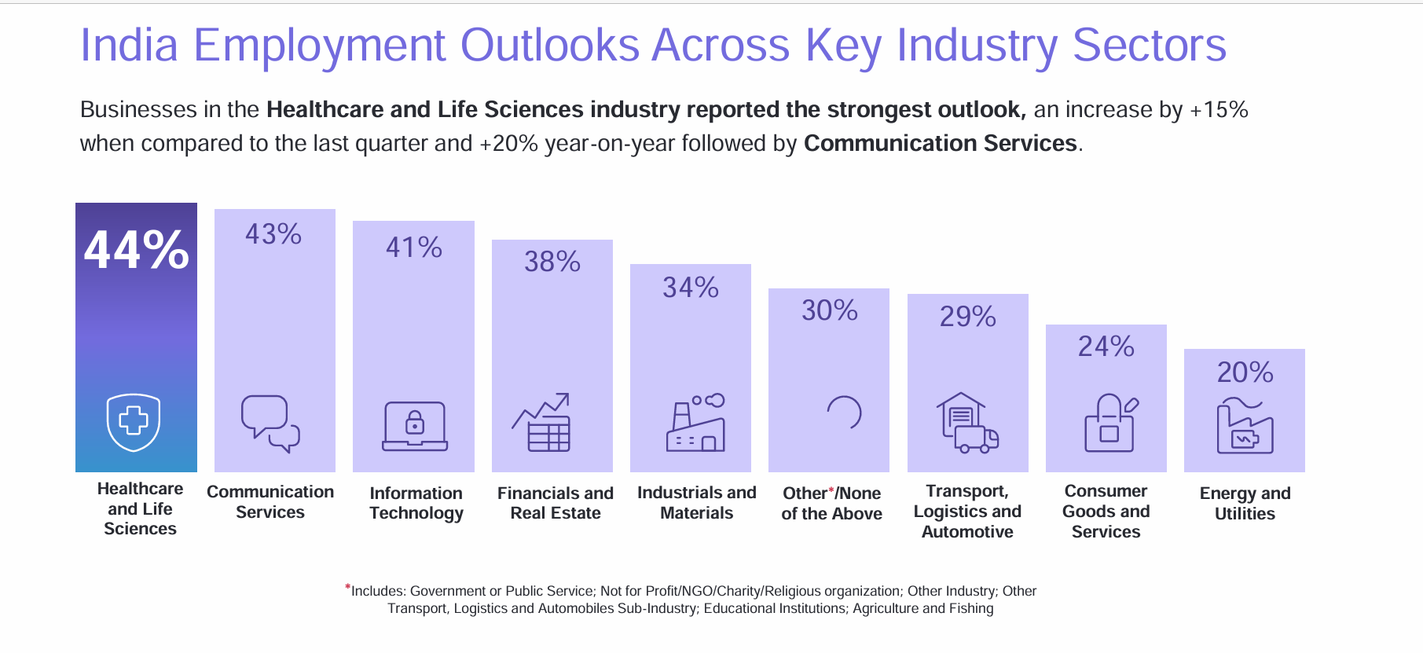
According to the report by Naukri Job Speak 2024 and Manpower Industry Outlook 2024, Healthcare and Real Estate will have the most growth in 2024.

Slide 8
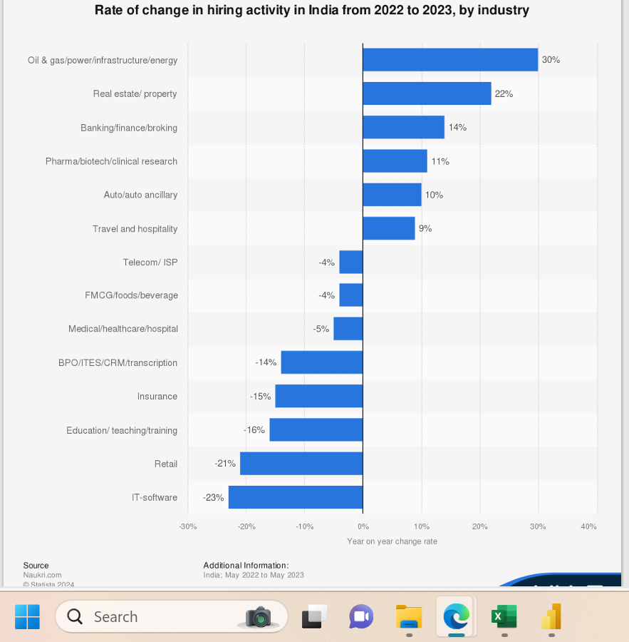
In 2023-24, the Talent’s share for Healthcare and Real Estate was 5% and 4%, respectively. Despite negative growth for the IT industry in India, the IT sector made the most profit for our company.

Slide 9
Employee Experience 2023-24

Slide 10
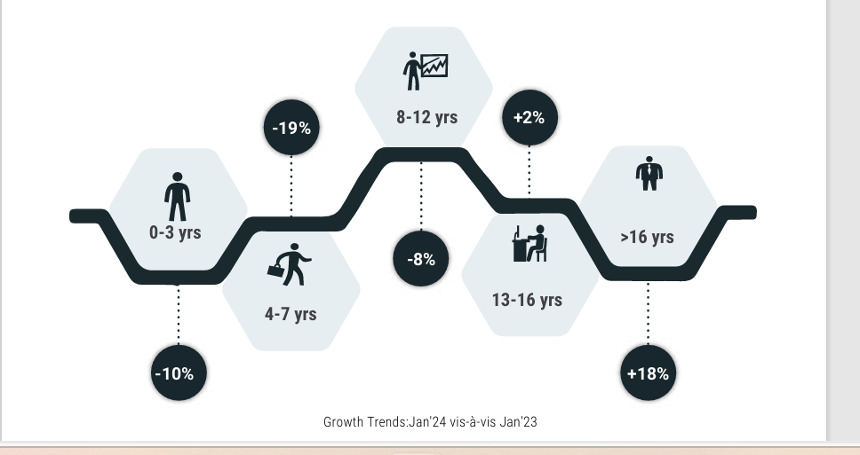
In 2023-24 most of the employees placed by us were in the bracket 4-7 years followed by 0-3 years, while only 7% were above 16 years experience.
According to the report by Naukri Job Speak 2024, there is positive momentum in hiring for employees in the experience bracket of 16+ years senior roles, while there is a negative trend for the 4-7 years and 0-3 years experience category.

Slide 11
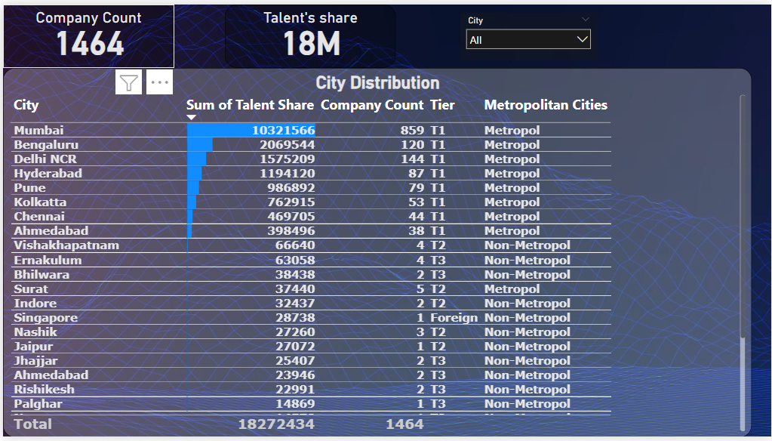
Talent’s profit across cities 2023-24

Slide 12
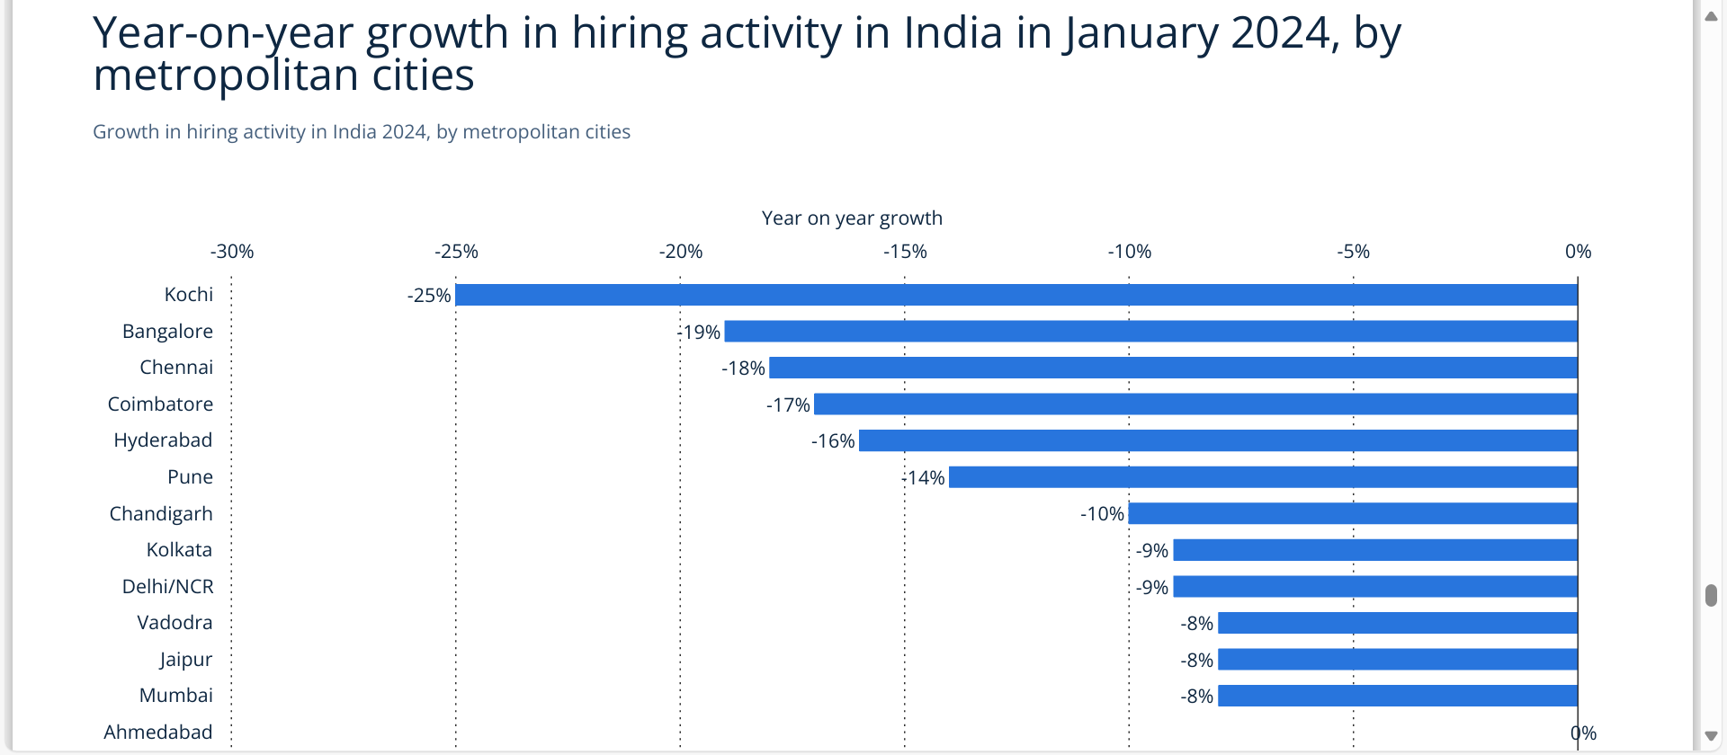
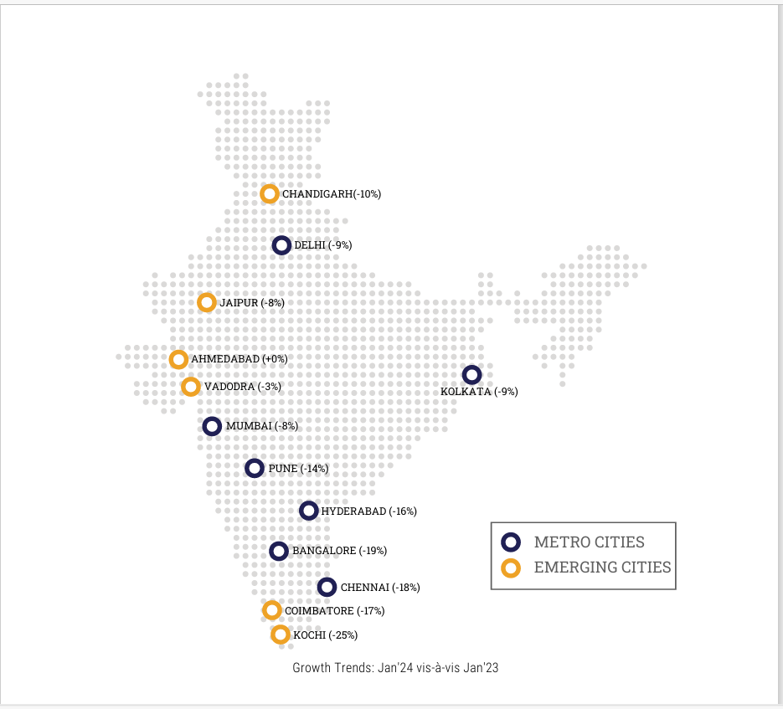
According to the report by Naukri Job Speak 2024 and Statista 2024, of all the cities, the greatest potential for hiring is in Ahmedabad, Delhi NCR, and Mumbai, being top cities despite negative growth. Jaipur, Vadodara, and Kolkata should be considered prime, too.

Slide 13
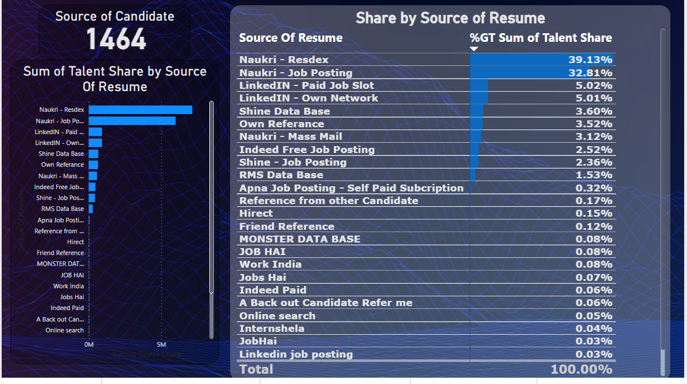
Talent’s Share by source of resume

Slide 14
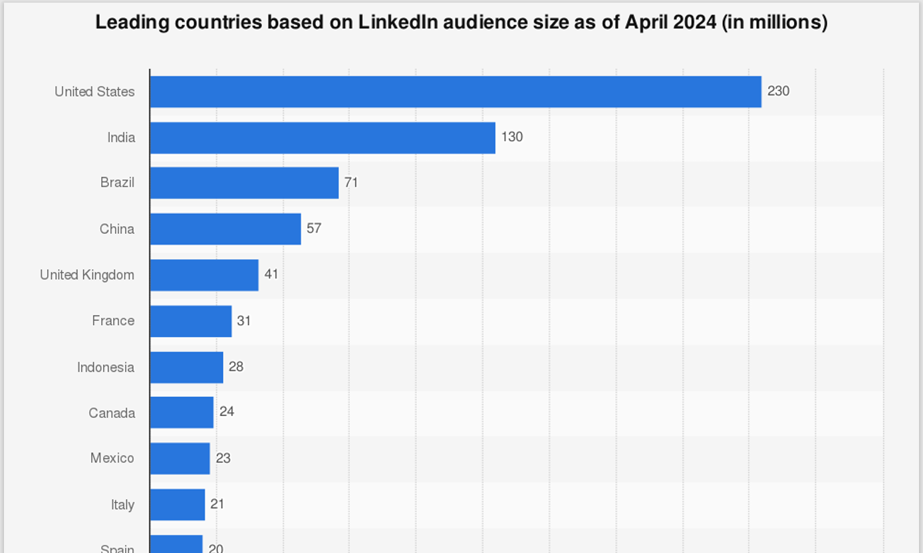
According to Statista 2024, India stands 2nd in the world with respect to LinkedIn users.

Slide 15
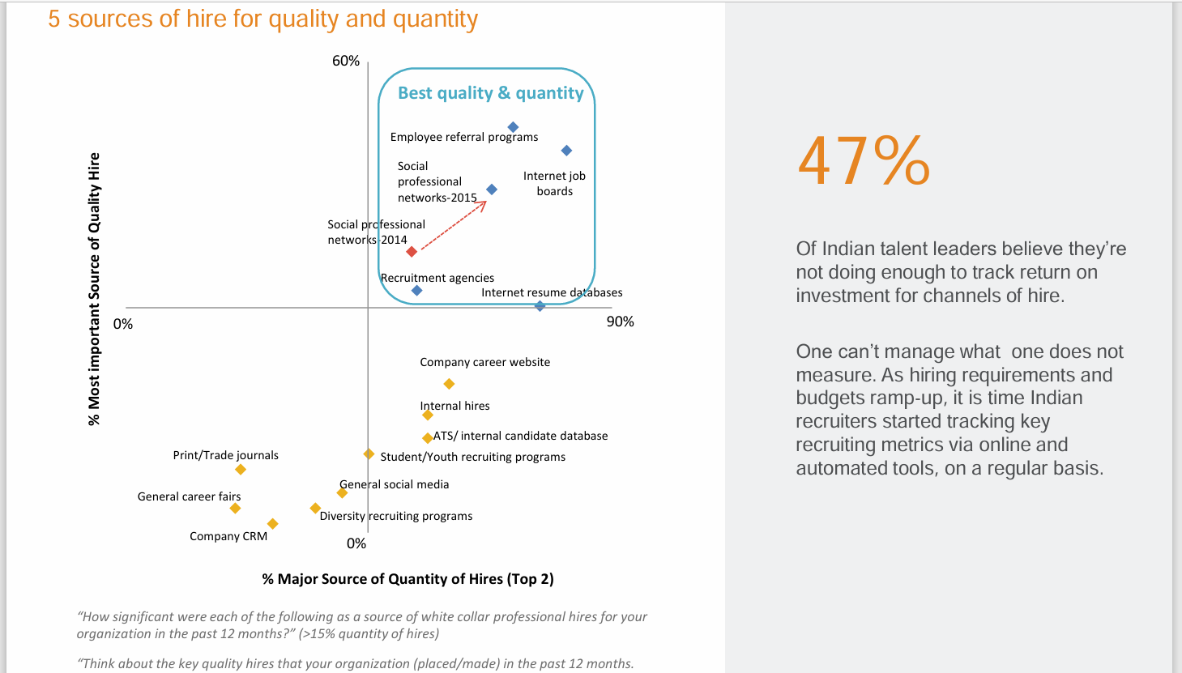
Also, according to the report by Statista 2024, the majority of quality and quantity of candidates can be sourced from Social Professional networks sites such as LinkedIn and referral programs. Both of the sources rank low for the company at 5% and 0.2 %, respectively.

Slide 16
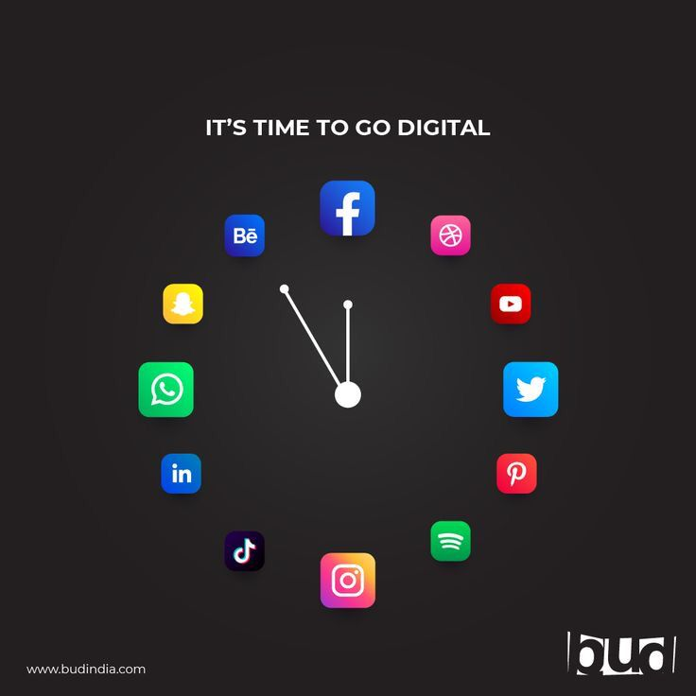

Slide 17
LINKEDIN ACCOUNT TALENT CORNER
At present, the About Me section is very basic; not much information is provided.
There is no emotional connection to pull people in to get attached.
Last post was uploaded 3 weeks ago.

Slide 18
LINKEDIN MARKETING STRATEGY
ABOUT DESCRIPTION
Break up paragraphs
Use bullet points
Greet your visitor and share what you’re all about
Create an emotional connection
Start with the why
What was the Aha moment that made you decide to take the path you’re on
Next, share what you offer: what I offer for clients, what I offer for candidates, what I offer for businesses

Slide 19
Be open about Getting in touch, open to receiving connection requests, and open to receiving WhatsApp messages or calls.

Slide 20
SOCIAL PROOF
The recommendation Section should have testimonials from clients, coworkers, and colleagues that help us establish ourselves as trustworthy.
Ways to use social proof through recommendations by adding testimonials in the About section
Creating images that include the recommendation text and attaching them to each experience
Ask clients or customers to record a short video testimonial to build more trust
Add a short video description to greet profile visitors to be added in the featured section to build comfort and trust.

Slide 21
LINKEDIN Live Video Ideas
Interviews with Industry leaders
Ask me Anything sessions(AMA)
Office or Workplace Tours

Slide 22
Regular Content Ideas for LinkedIn
Polls: Ask the audience for their opinion, icebreaker questions
Company innovation, company news, mergers, profits, losses, motivation quotes, company activities, company fun activities, celebrations, festivals, company parties, employee birthdays celebrations, happy feelings, past employee experiences, location pictures, office infrastructure.

Slide 23
Business Development Efforts
Ten-second thank you videos for all connections or people who helped us achieve our goals
Use Animated tutorials, Client transformations

Slide 24
TWITTER ACCOUNT TALENT CORNER
The last post was posted 6 years ago
Twitter Bio not optimized
USE Social Media Management Systems such as Sprout Social and Iconosquare to manage LinkedIn, Instagram, Facebook,Twitter together to get combined Analytics.

Slide 25
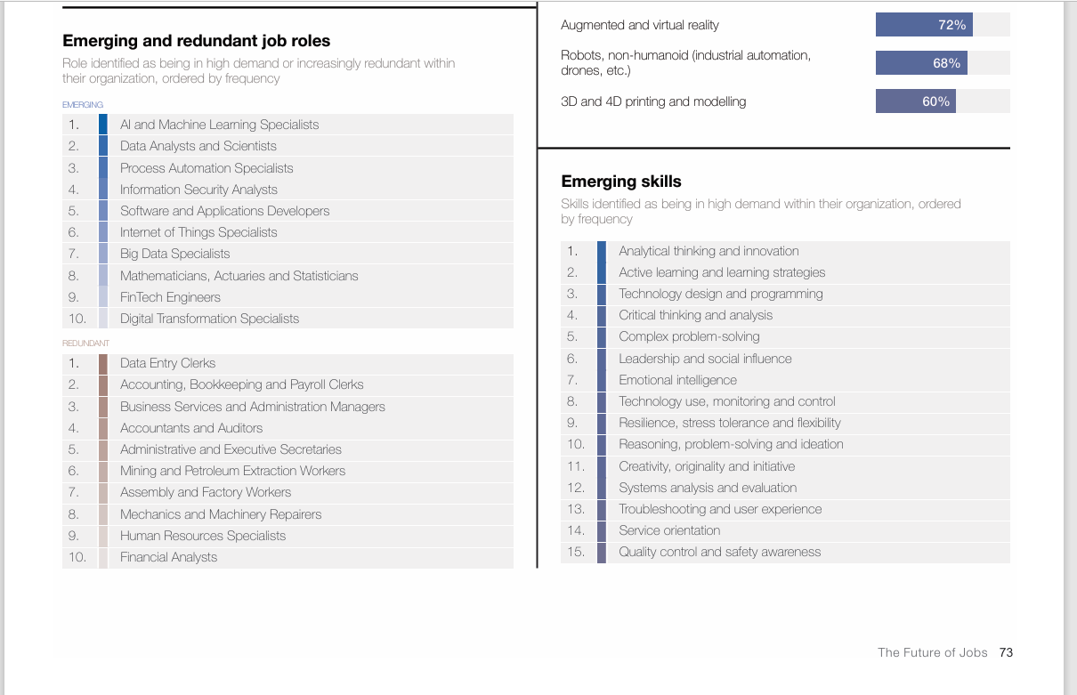
Emerging and Redundant Skills

Slide 26
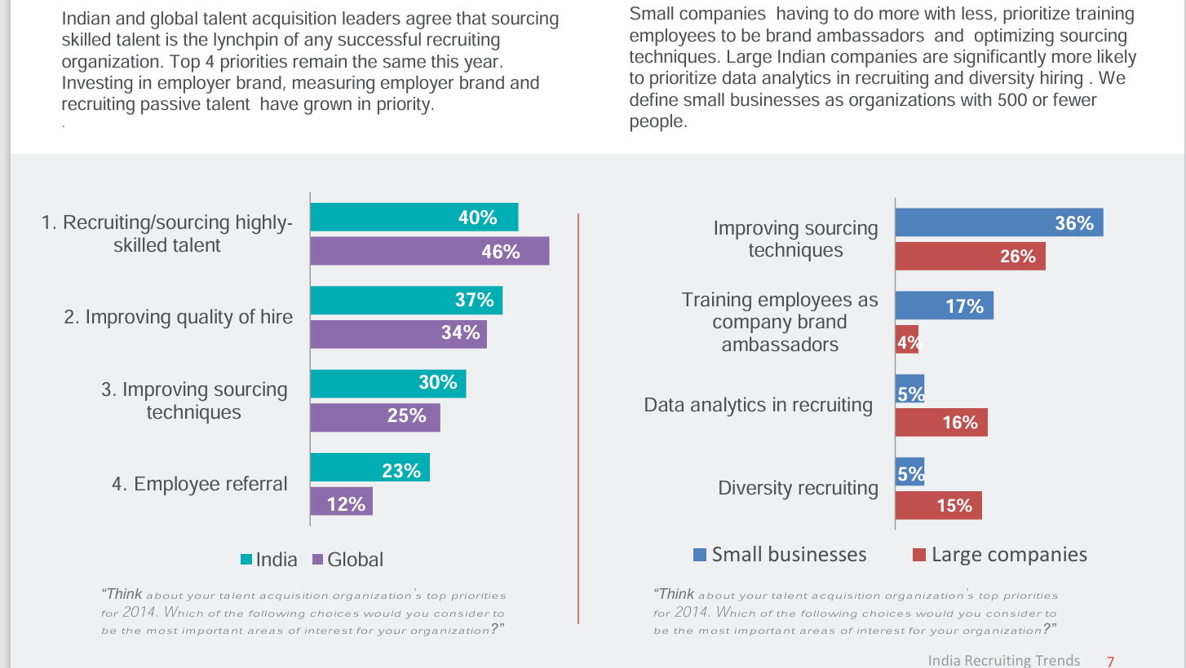
Employee Referrals

Slide 27
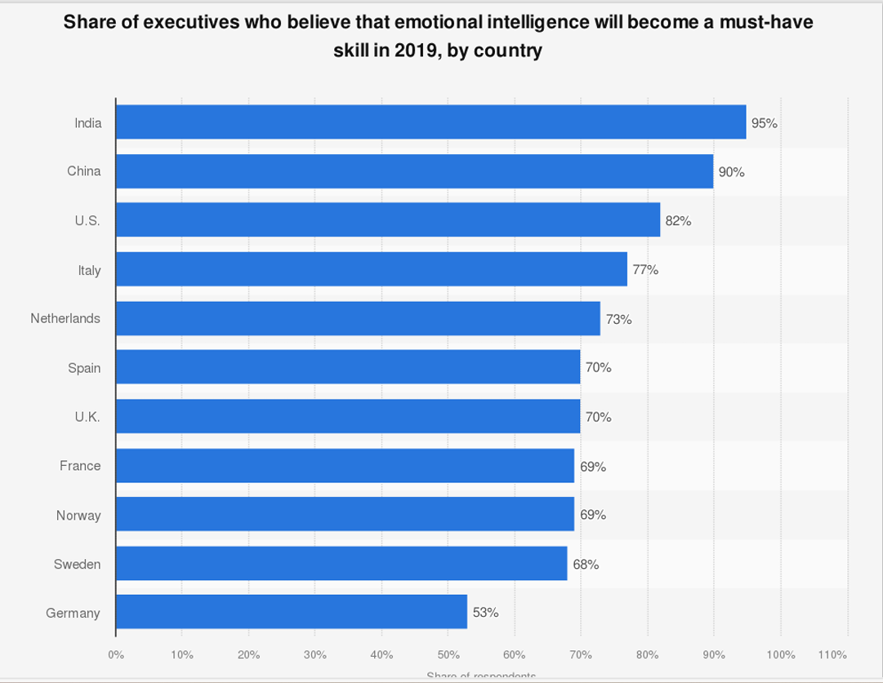
Training Clients and Candidates Emotional Intelligence skill Through webinars to remain relevant

Slide 28
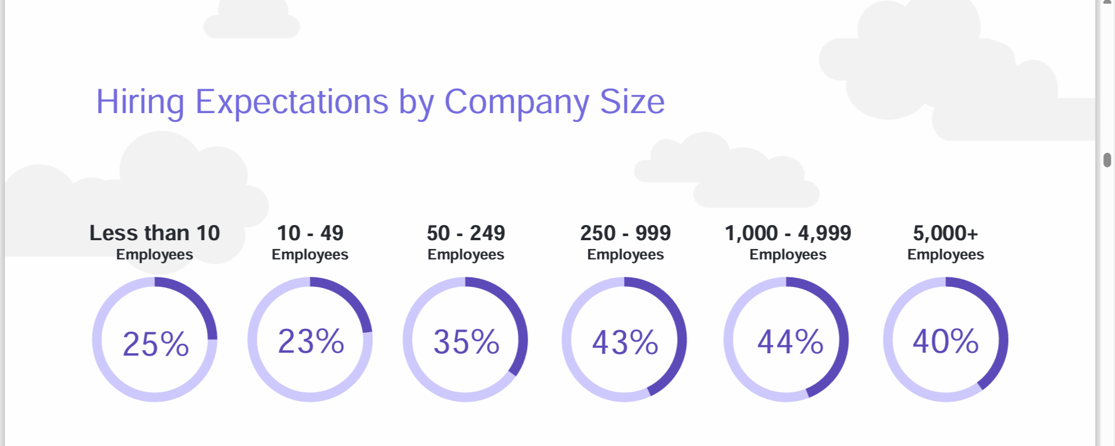
Hiring expectations by company size

Slide 29
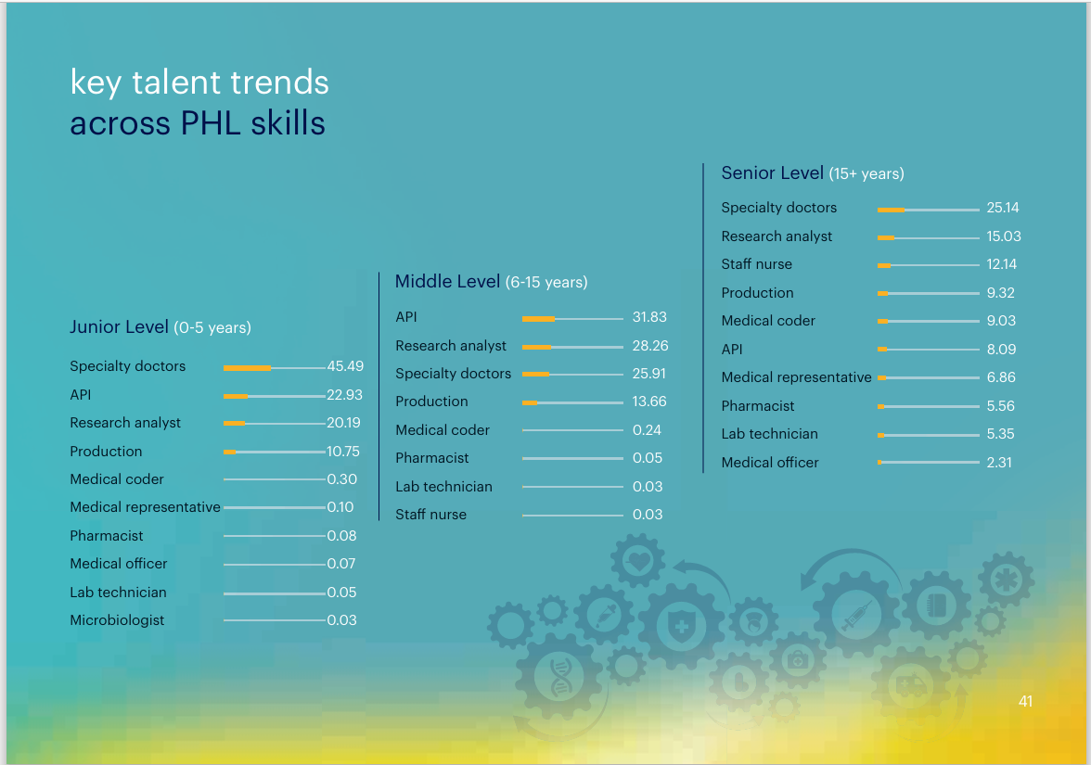
Randstad Report on key PHL skills

Slide 30
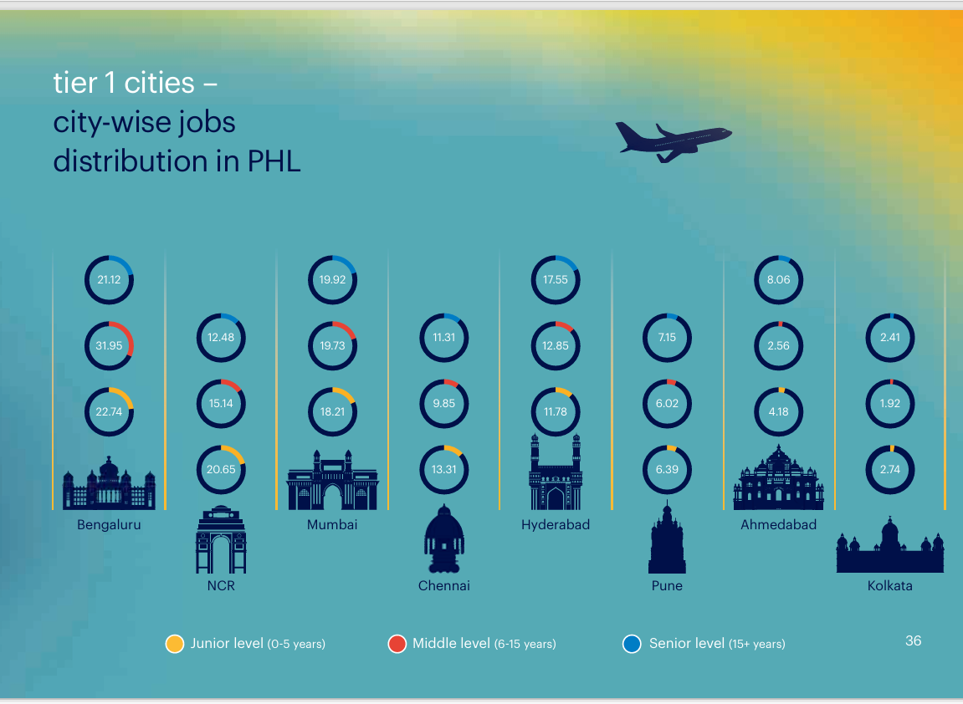
Randstad Report on City-Wise Job Distribution

Slide 31

Thank You

